Slide 1


Fabián Camilo Lozano Calderón
August 2023

Slide 2

Outline
Executive Summary
Introduction
Methodology
Results
Conclusion
Appendix

Slide 3
Executive Summary
Summary of methodologies
Data Collection
Data Collection with Web scraping
Data Wrangling
EDA using SQL
EDA Data Visualization using Pandas
Building interactive Dashboards
Machine Learning Predictions
Summary of all results
EDA Querys and results
Dashboards
Predictive Analysis

Slide 4
Introduction
Project background and context
SpaceX advertises Falcon 9 rocket launches on its website with a cost of 62 million dollars; other providers cost upward of 165 million dollars each, much of the savings is because SpaceX can reuse the first stage.
This information can be used if an alternate company wants to bid against SpaceX for a rocket launch
Problems you want to find answers
Predict if the Falcon 9 first stage will land successfully

Slide 5

Section 1

Slide 6
Methodology
Executive Summary
Data collection methodology:
Describe how data was collected
Perform data wrangling
Describe how data was processed
Perform exploratory data analysis (EDA) using visualization and SQL
Perform interactive visual analytics using Folium and Plotly Dash
Perform predictive analysis using classification models
How to build, tune, evaluate classification models

Slide 7
Data Collection
The datasets were collected from the spacex site where they were abstracted through Restful_API. Filtering by rockets, launchpads, cores, launches. Passing that information to dataframes by pandas, then a dealed with missing values was done by replacing with average values.

Slide 8
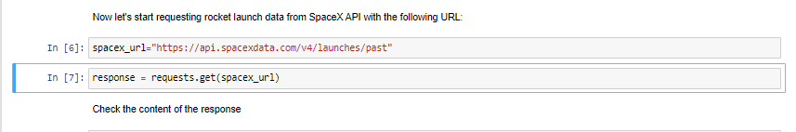
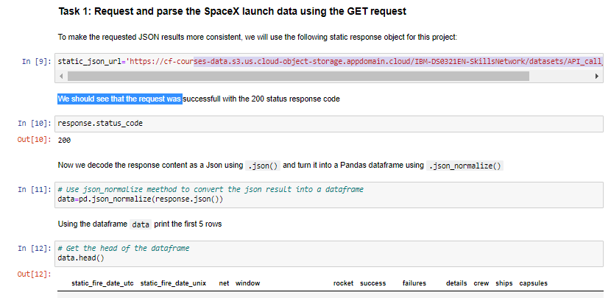
Data Collection – SpaceX API
The content was decoded from the response as a Json using .json() and converted to a Pandas dataframe using .json_normalize().
Add the GitHub URL of the completed SpaceX API calls notebook, https://github.com/familo91/Capston-IBM-DataScience/blob/master/1.DataCollection/jupyter-labs-spacex-data-collection-api.ipynb

Slide 9
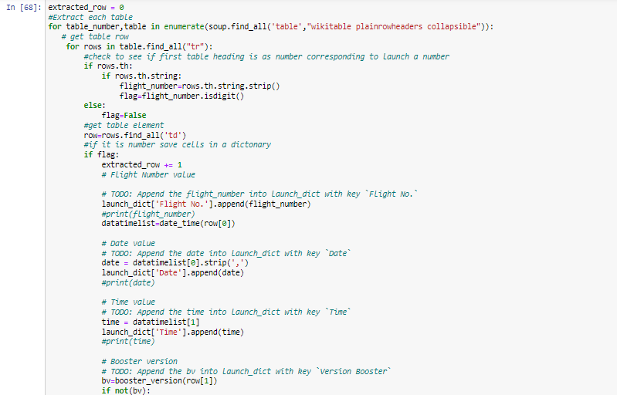
Data Collection - Scraping
The extraction of data from the falcon 9 launch table was done by webscraping a wikipedia URL using a beatiful soup object, the columns of the frame and its content were organized by means of the append instruction creating a dataframe.
Add the GitHub URL of the completed web scraping notebook, https://github.com/familo91/Capston-IBM-DataScience/blob/master/2.Data_Wrangling/labs-jupyter-spacex-Data%20wrangling.ipynb

Slide 10
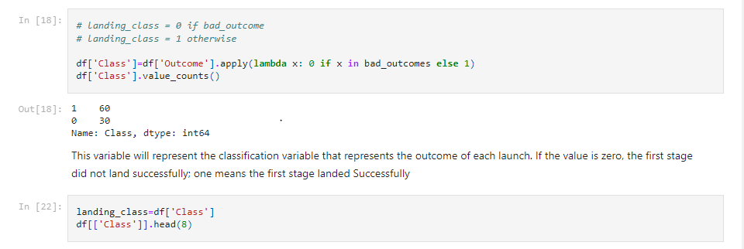
Data Wrangling
We used pandas and numpy to find out the success rate, we used functions such as value_counts and mean, we created a column to determine the land succesfully in a boolean way.
Add the GitHub :https://github.com/familo91/Capston-IBM-DataScience/blob/master/2.Data_Wrangling/labs-jupyter-spacex-Data%20wrangling.ipynb

Slide 11
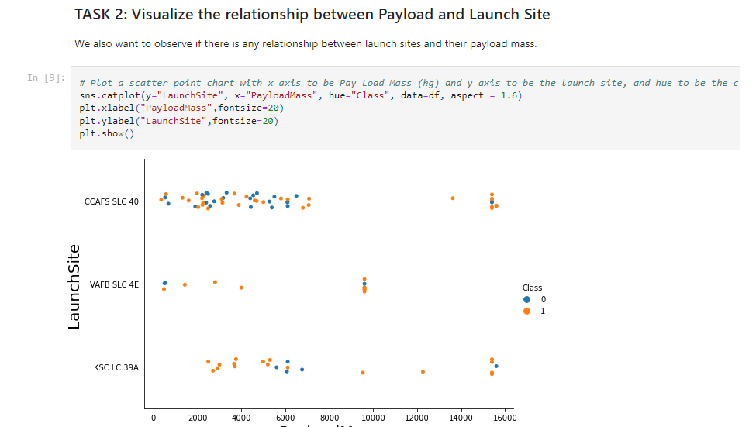
EDA with Data Visualization
The relationship between the number of flight and launches, the success rate of each type of orbit and the annual launch success are verified by pyplot. Using scatter point chart and bar chart
Add the GitHub URL of your completed EDA with SQL notebook, as an external reference and peer-review purpose: https://github.com/familo91/Capston-IBM-DataScience/blob/master/5.%20EDA%20-Visualization%20Tools/jupyter-labs-eda-dataviz%20(1).ipynb

Slide 12
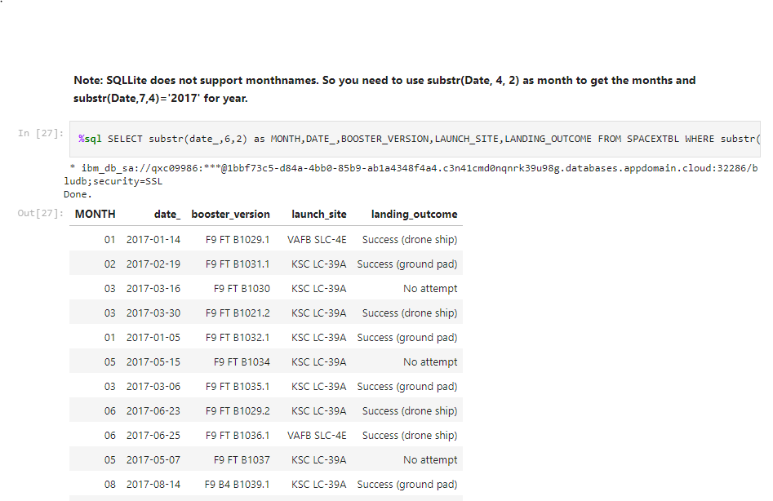
EDA with SQL
In this case the csv file was uploaded in IBM CLOUD and the database was created and queries were performed with searches for weight, success ground pad and launch dates.
Add the GitHub URL:https://github.com/familo91/Capston-IBM-DataScience/blob/master/4.EDA-SQL/jupyter-labs-eda-sql-edx_sqllite.ipynb

Slide 13
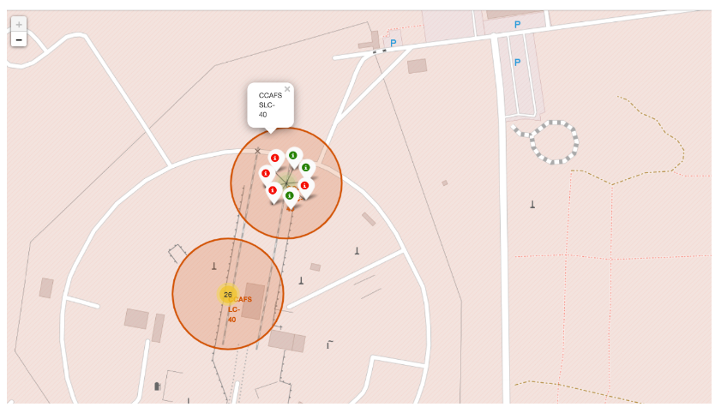
Build an Interactive Map with Folium
Each one of the launches was positioned according to its longitude and latitude, this allowed us to have clarity on which launches and where they had a higher success rate, finally we calculated the distance of the launches with respect to the coast.
Add the GitHub URL: https://github.com/familo91/Capston-IBM-DataScience/blob/master/6.Interactive%20Visual%20Analytics/lab_jupyter_launch_site_location.jupyterlite.ipynb

Slide 14
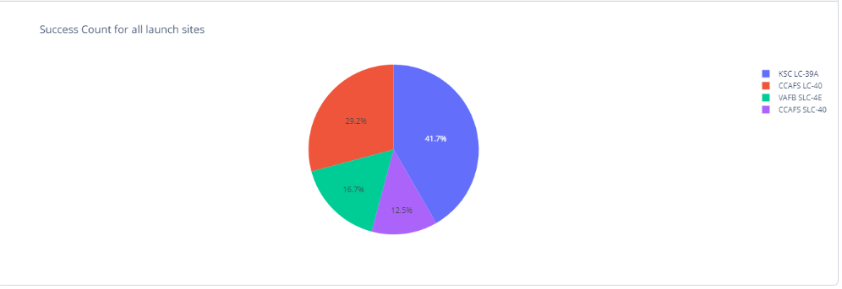
Build a Dashboard with Plotly Dash
A dashboard was created so that each launch could be dynamically filtered by Payload range, success count launch, site, etc.
Add the GitHub URL:https://github.com/familo91/Capston-IBM-DataScience/blob/master/7.Build%20and%20interactive%20Dash/spacex_dash_app.py

Slide 15
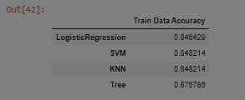
Predictive Analysis (Classification)
The class column was assigned as variable Y and as X the URL dataframe, the network was trained with 20% of the data, the methods of Logist_reg,SVM,Desicion tree,KNN were used to find the best training parameters and the accuracy according to the score the winner is Tree with 0.8767
Add the GitHub URL:https://github.com/familo91/Capston-IBM-DataScience/blob/master/8.%20Complete_Machine_Learning/module_4_SpaceX_Machine_Learning_Prediction_Part_5.jupyterlite.ipynb

Slide 16
Results
Exploratory data analysis results
Interactive analytics demo in screenshots
Predictive analysis results

Slide 17

Section 2

Slide 18
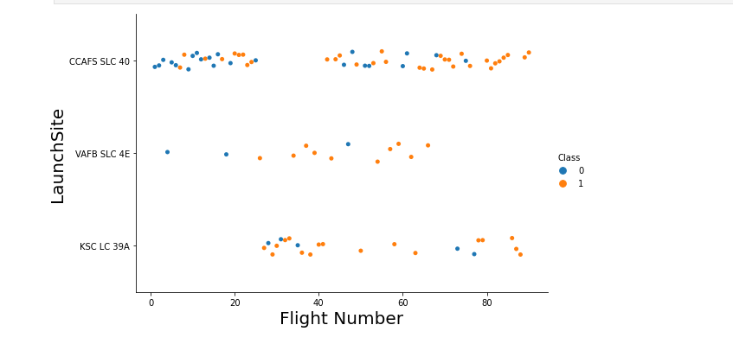
Flight Number vs. Launch Site
Whe can see CCAFS: After fly 80 the success is 100 percent
Whe can see VAFB: After fly 50 the success is 100 percent
Whe can see KSC LC Before fly 80 the success is 100 percent

Slide 19
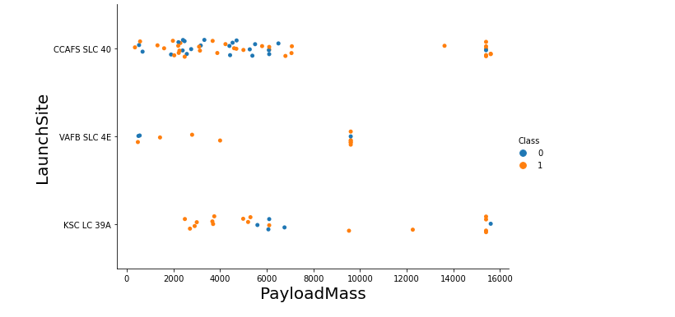
Payload vs. Launch Site
Now if you observe Payload Vs. Launch Site scatter point chart you will find for the VAFB-SLC launchsite there are no rockets launched for heavypayload mass(greater than 10000).

Slide 20
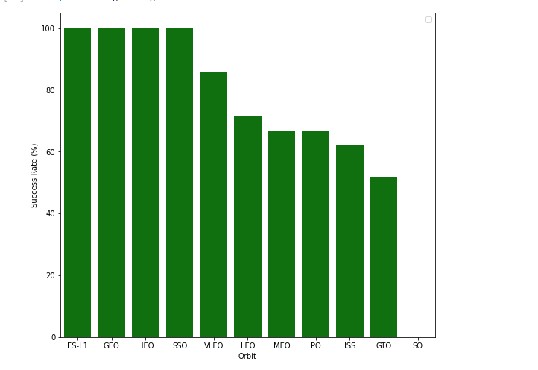
Success Rate vs. Orbit Type
the orbits with 100% success rate are ESL1, GEO, HEO, SSO, the lowest success rate is GTO.

Slide 21
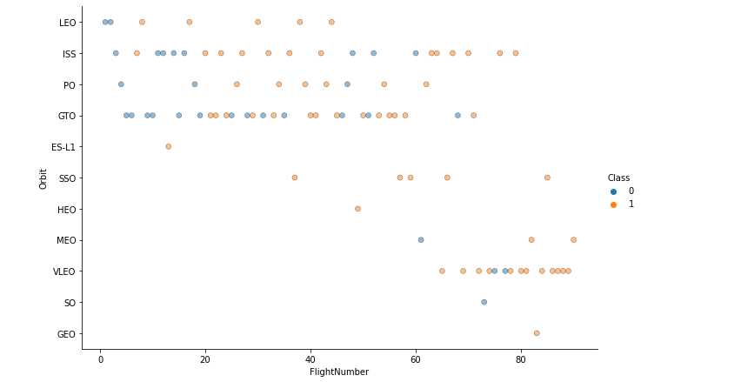
Flight Number vs. Orbit Type
You should see that in the LEO orbit the Success appears related to the number of flights; on the other hand, there seems to be no relationship between flight number when in GTO orbit.

Slide 22
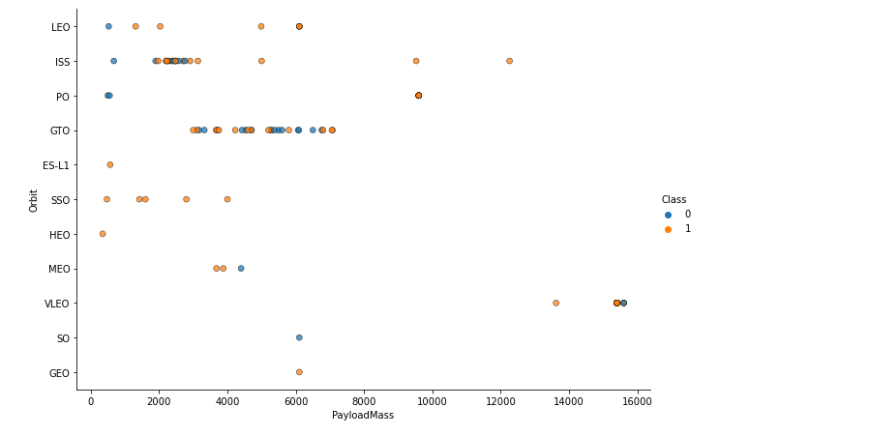
Payload vs. Orbit Type
With heavy payloads the successful landing or positive landing rate are more for Polar,LEO and ISS.
However for GTO we cannot distinguish this well as both positive landing rate and negative landing(unsuccessful mission) are both there here.

Slide 23
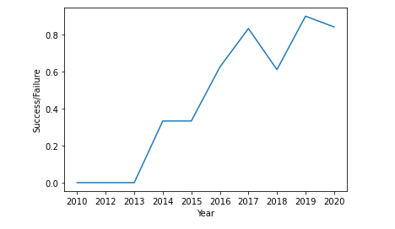
Launch Success Yearly Trend
You can observe that the sucess rate since 2013 kept increasing till 2020

Slide 24
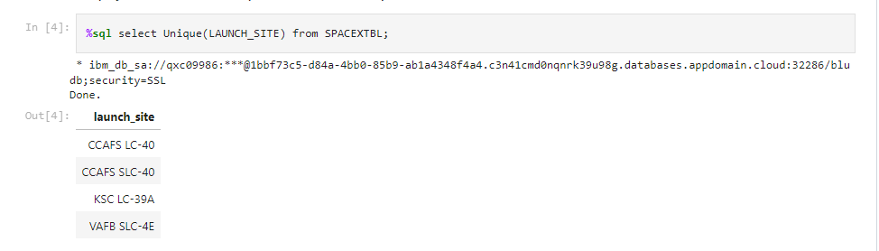
All Launch Site Names
For this case I used a select with unique search for not repeat the result

Slide 25
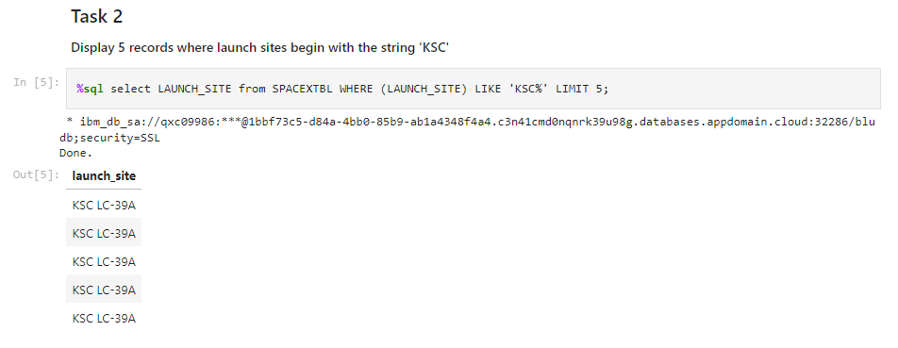
Launch Site Names Begin with 'KSC'
For these exercise you have to use LIKE to search the letters and a Limit for the quantity of searchs

Slide 26
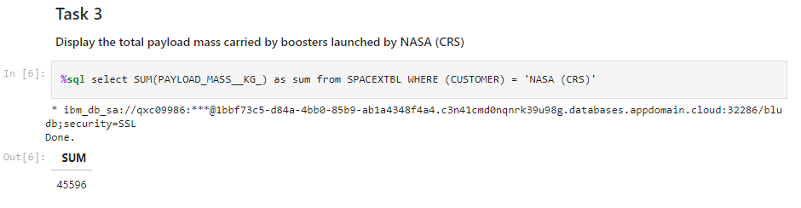
Total Payload Mass
You have to use math operation of sum with clause in column customer, 45596 KG is the total payload used for the customer NASA

Slide 27
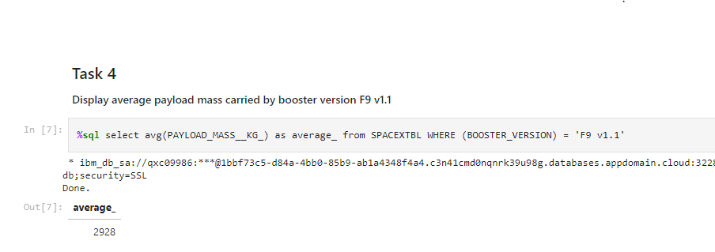
Average Payload Mass by F9 v1.1
The average payload mass carried by booster version F9 v1.1 is 2928Kg

Slide 28
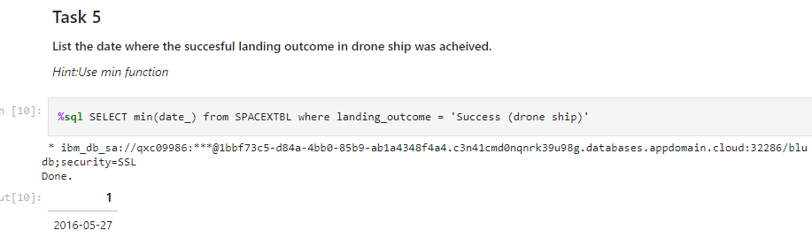
First Successful Ground Landing Date
The successful landing outcome was 2016-05-27

Slide 29
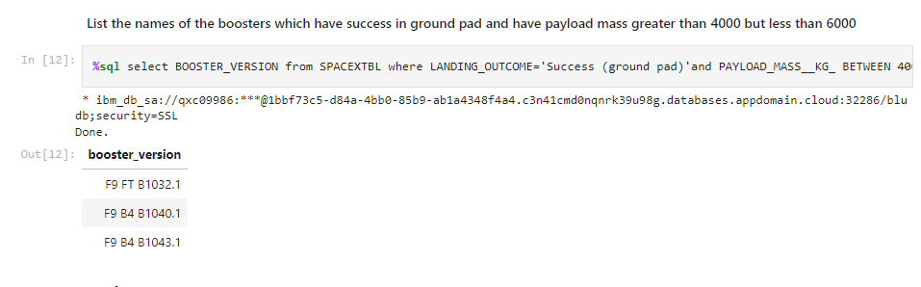
Successful Drone Ship Landing with Payload between 4000 and 6000
For this query is necessary use the function between in the conditional

Slide 30
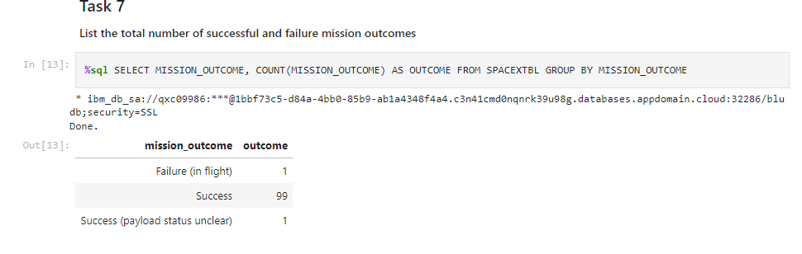
Total Number of Successful and Failure Mission Outcomes
The total of success was 99 , the failure was 1, for this query a group was used.

Slide 31
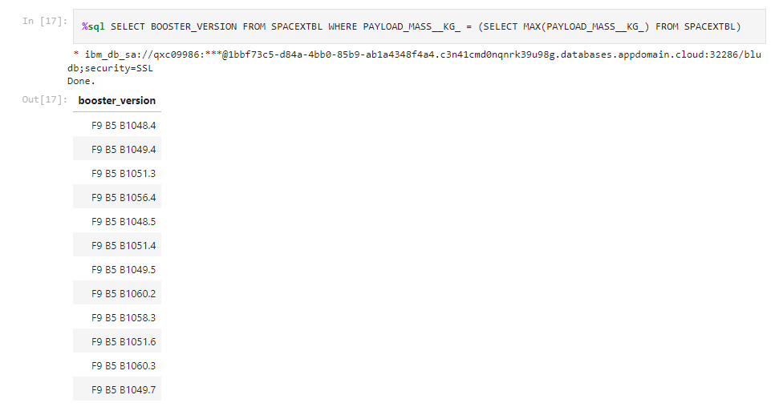
Boosters Carried Maximum Payload
For this query Max function was used for filter booster version

Slide 32
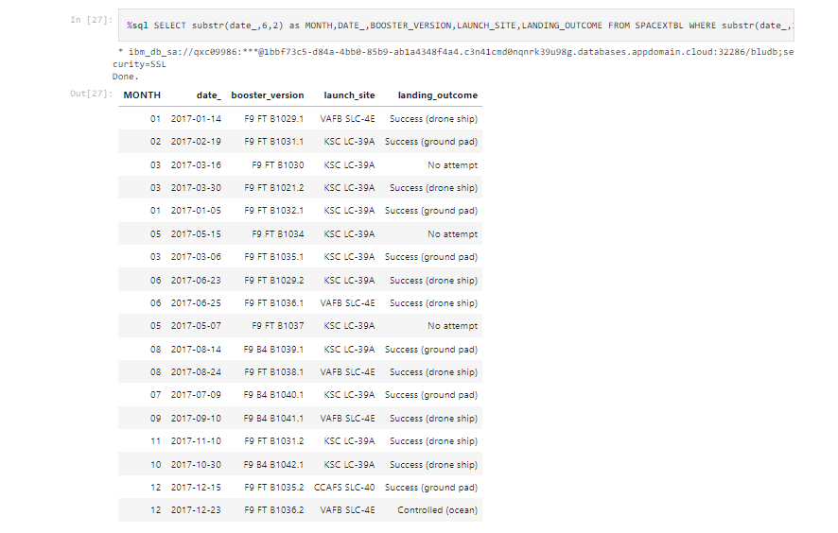
2017 Launch Records
For this query, function must be used substr(Date, x, y) to filter month

Slide 33
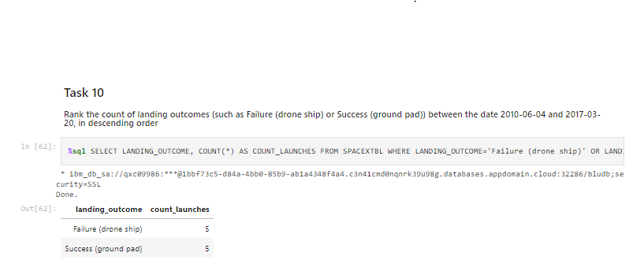
Rank Landing Outcomes Between 2010-06-04 and 2017-03-20
For this query filter by date with the same function as last example, and filter by column failure (drone ship) and success (ground pad) name counting with desc function

Slide 34

Section 3

Slide 35
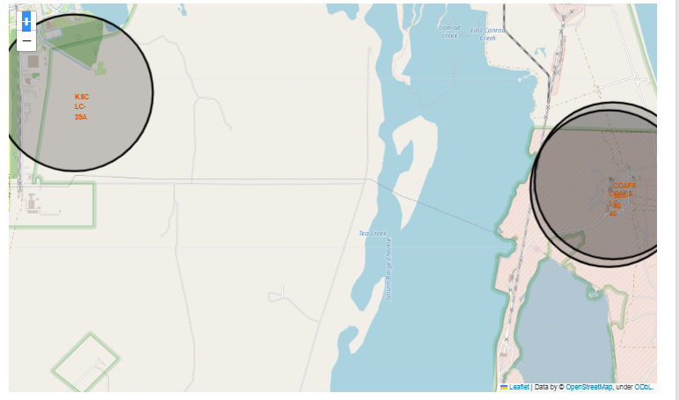
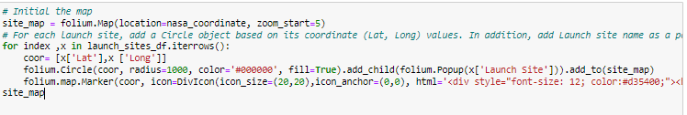
<Launches sites>
With folium.circle and folium.map.Marker using the coordinates is possible draw in the map the launches sites

Slide 36
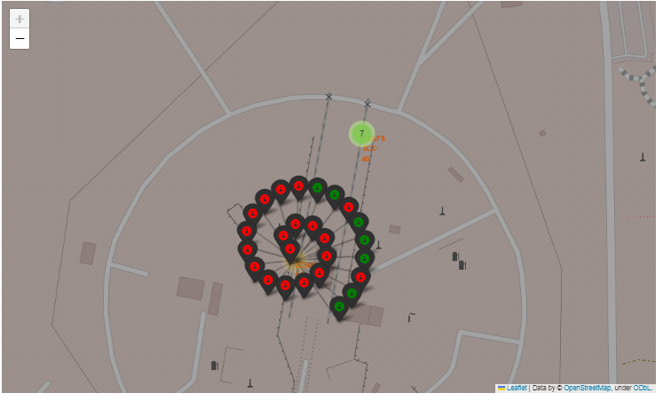
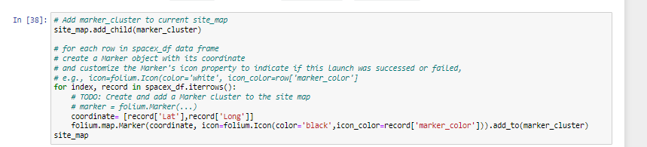
<Success/Failed Launches>
From the color-labeled markers in marker clusters, you should be able to easily identify which launch sites have relatively high success rates

Slide 37
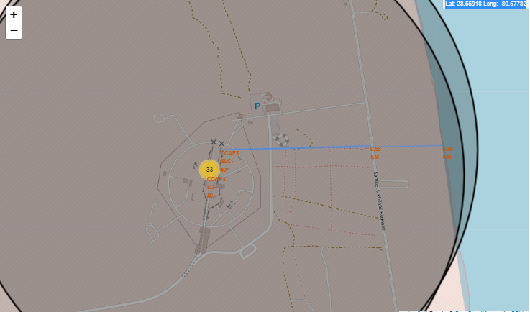
<Distance between launch sites>
Calculations can be made with other distance coordinates, in this case the calculation to the coastline was 0.89 km.

Slide 38

Section 4

Slide 39
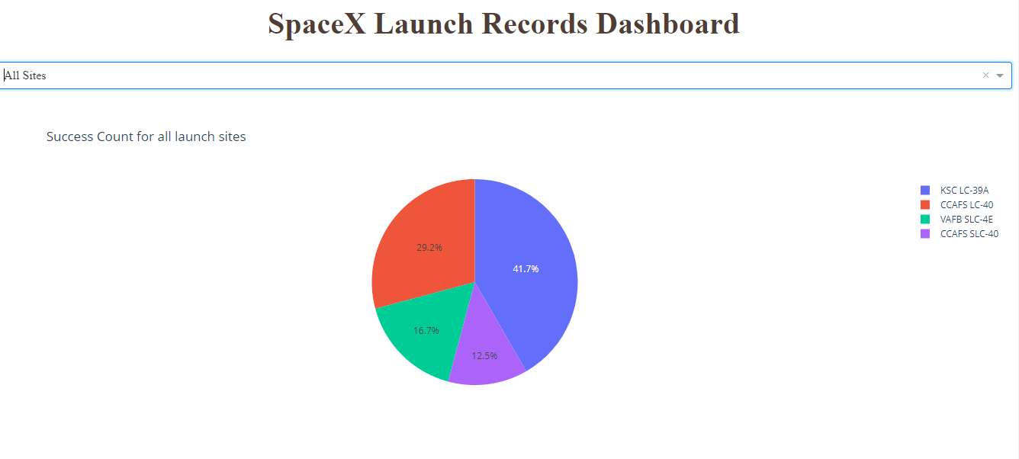
<Success Count>
KSCLC39 had the major number of success count, followed by CCAFS LC-40

Slide 40
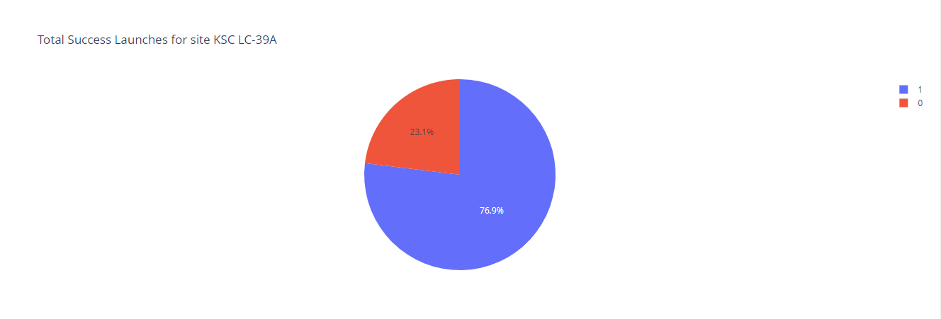
<Total Success Launches KSC-39A>
The percent of success for KSC-LC 39A was 79.6%

Slide 41
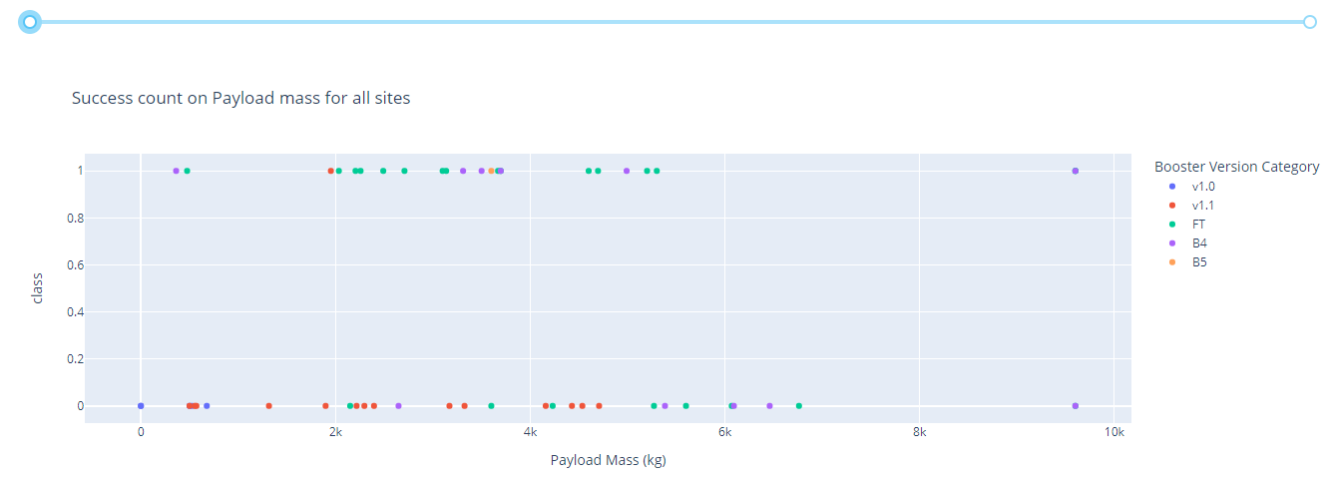
< Payload Mass vs Booster Version >
.

Slide 42
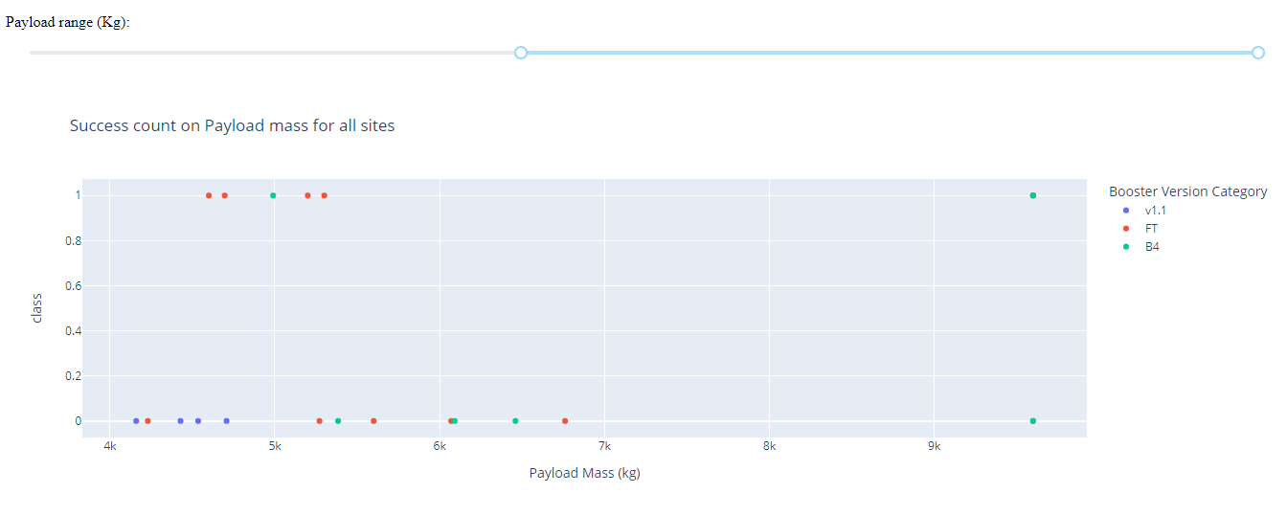
<Payload Mass vs Booster Version>
.
Above 5000kg the unique version that found was V1.1 ,FT, B4. For 10000 kg the version that support this load is B4

Slide 43

Section 5

Slide 44
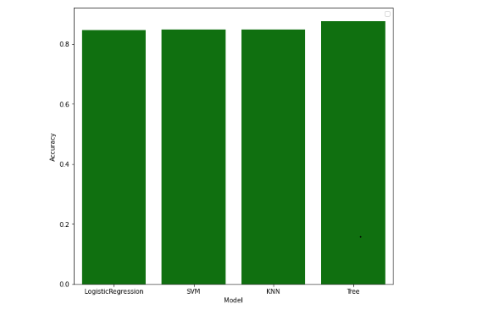
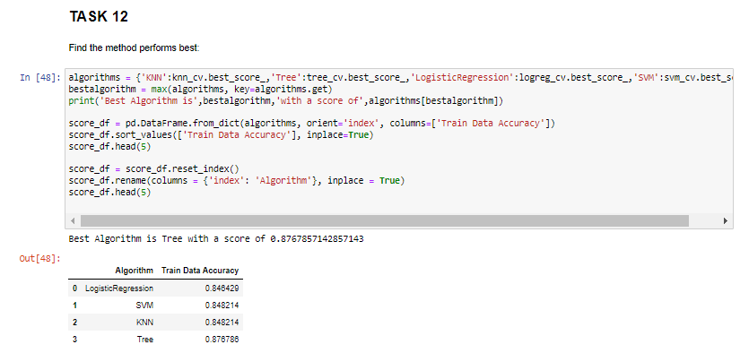
Classification Accuracy
The model of best classification of accuracy is tree .

Slide 45
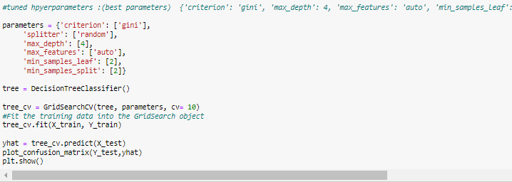
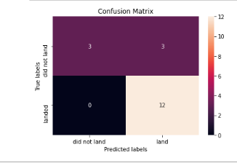
Confusion Matrix
With the best parameters, we can see that the sum of 20% of training dates is 18, we have 12 True positives, 3 True negatives, 3 falses Positives, 0 False negative

Slide 46
Conclusions
The Falcon 9 first stage will land successfully
For 10000 kg the version that support this load is B4
The percent of success for KSC-LC 39A was 79.6%
KSCLC39 had the major number of success count, followed by CCAFS LC-40
You can observe that the sucess rate since 2013 kept increasing till 2020
The orbits with 100% success rate are ESL1, GEO, HEO, SSO, the lowest success rate is GTO
The model of best classification of accuracy is tree .
We had a model that can predict the success of stage with X inputs
…

Slide 47
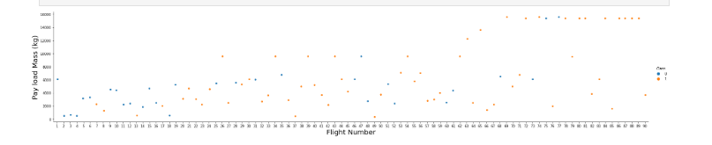
Appendix

Slide 48


